Slide 1
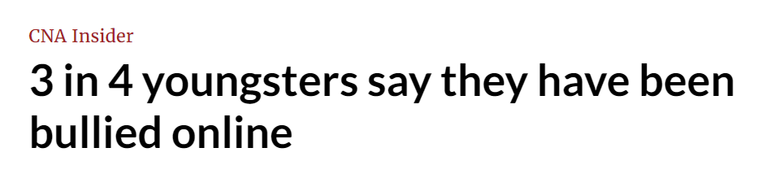

Slide 2

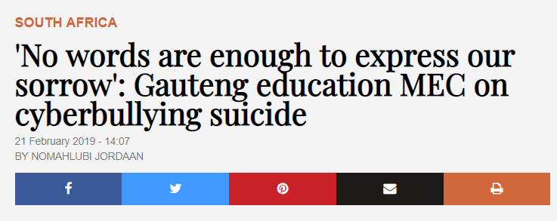
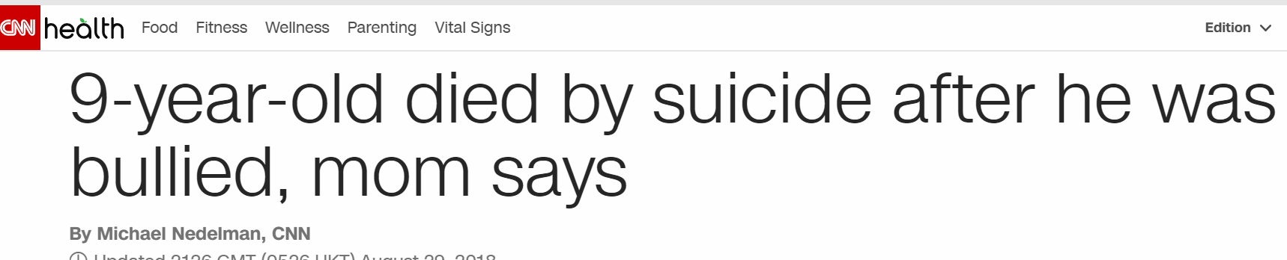
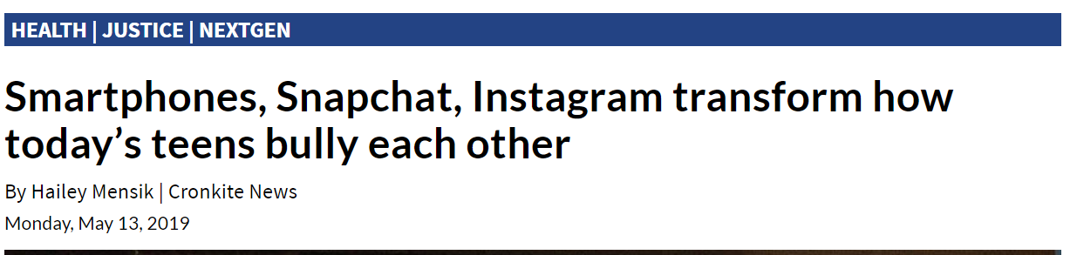

Slide 3

Toxic Comments Screener™
Edward Bingei
Data Analyst
METIS Group Pte Ltd

Slide 4



Our Value Proposition
Tool that recognizes and assigns probabilities to various types of toxic comments.

Slide 5


Understanding the Data
159,571
comments
Toxic
Severe Toxic
Obscene
Insult
Threat
Identity Hate
Yes (1)
No (0)

Slide 6
Understanding the Data
159,571
data points
6
categories
2
results
Toxic
Severe Toxic
Obscene
Insult
Threat
Identity Hate
Yes (1)
No (0)

Slide 7
Understanding the Data
159,571
data points
6
categories
2
results
Toxic
Severe Toxic
Obscene
Insult
Threat
Identity Hate
Yes (1)
No (0)

Slide 8
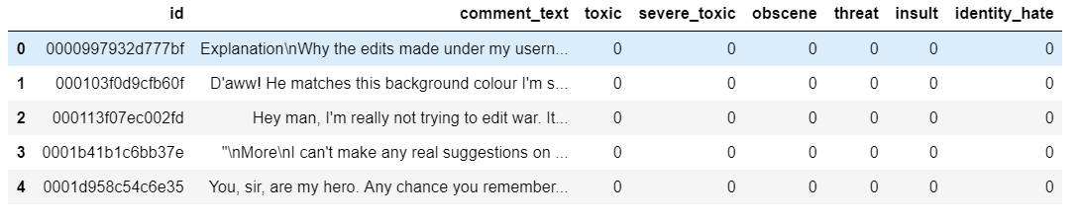
An Example

Slide 9
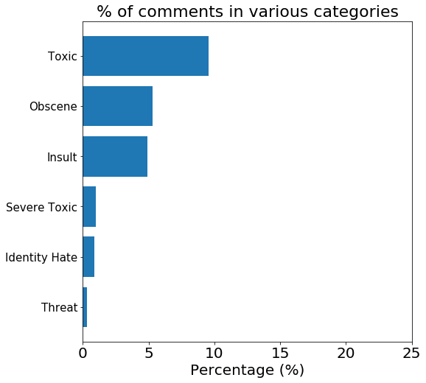
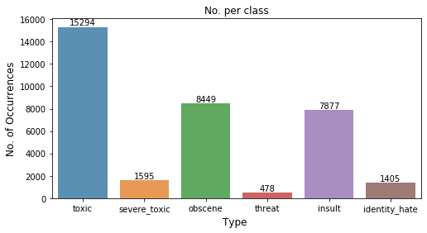
Toxic Comments by % and Count

Slide 10
Toxic Comments by % and Count

Slide 11
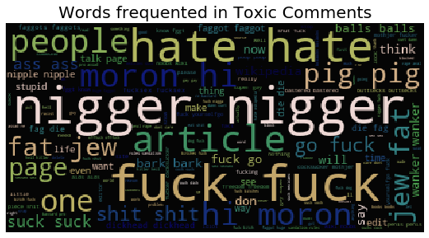
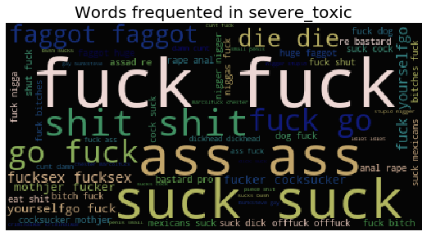
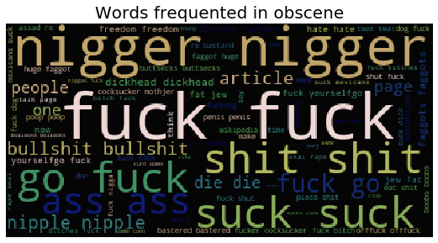
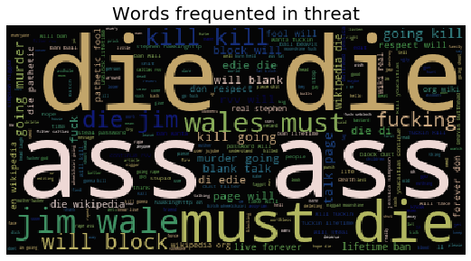
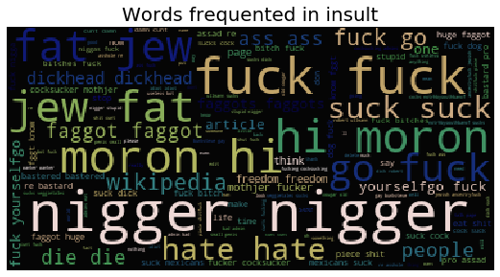
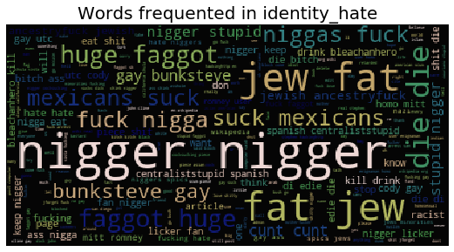
Introducing VulgarClouds™

Slide 12
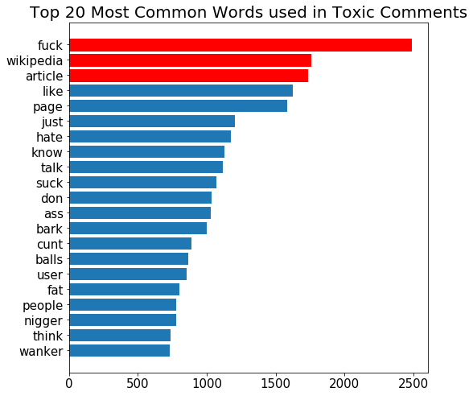
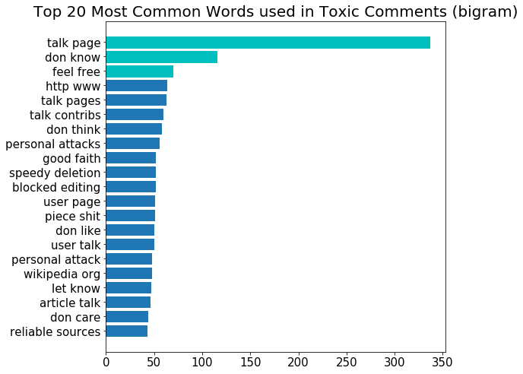
Uni-gram VS Bi-gram

Slide 13
Problems & Solutions
Multiple target
variables
Separate data to 6 sections (1 category each)
Limit to 10k per category
Data too large

Slide 14
Problems & Solutions
Multiple target
variables
Separate data to 6 sections (1 category each)

Slide 15
Problems & Solutions
Multiple target
variables
Separate data to 6 sections (1 category each)
Data too large
(Memory Error)
Limit to 10k per category

Slide 16
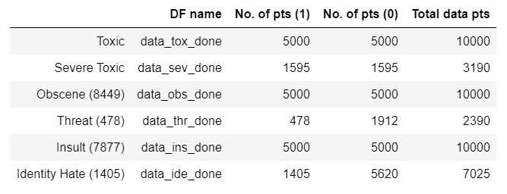
Problems & Solutions
Data too large
(Memory Error)
Limit to 10k per category

Slide 17
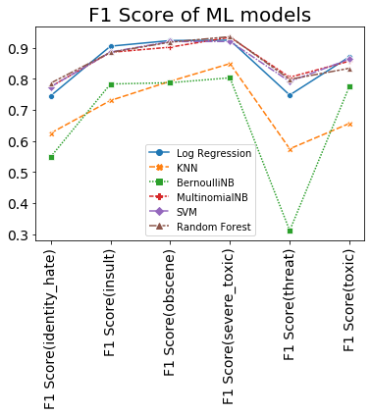
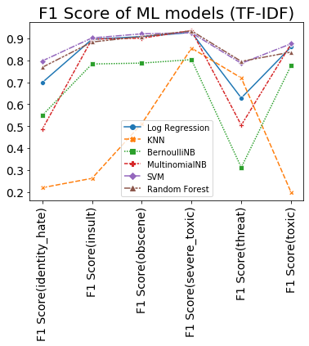
SVM and RDF are excellent performers across all categories
(Count Vectorizer)

Slide 18
SVM and RDF are excellent performers across all categories
(TF-IDF)

Slide 20
Conclusion
Not rocket science - we can detect & assign probabilities to some toxic comments
Random Forest is a useful model

Slide 21
Future Work
Limited to 10,000 rows of data per category
Look at other data sources (Twitter)
Create new features (e.g. length of comments, length of sentences, number of capital letters)

Slide 22
Let’s make our digital world safe. Get Toxic Comments Screener today for ONLY: US$8,888.88

Slide 23
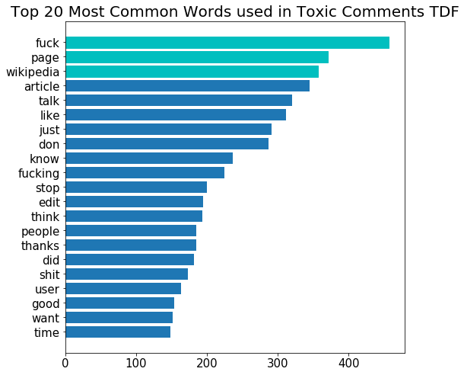
CV vs TF-IDF

